Slide 1






PANTHER SHUTTLE APP
https://yanarex.github.io/shuttle-app-website/
Members: Joseph Hilte, Tony Arrington, Jonathan Suo, and Chase Monigle

Slide 2







Main Objectives
Work on Home Tab.
Implement Student side Home Tab.
Work on Settings Tab.
Implement Settings Tab
Begin Driver Side of the App.
Basic UI Switch is done.
Improve Mapping System.
Map now displays location.

Slide 3

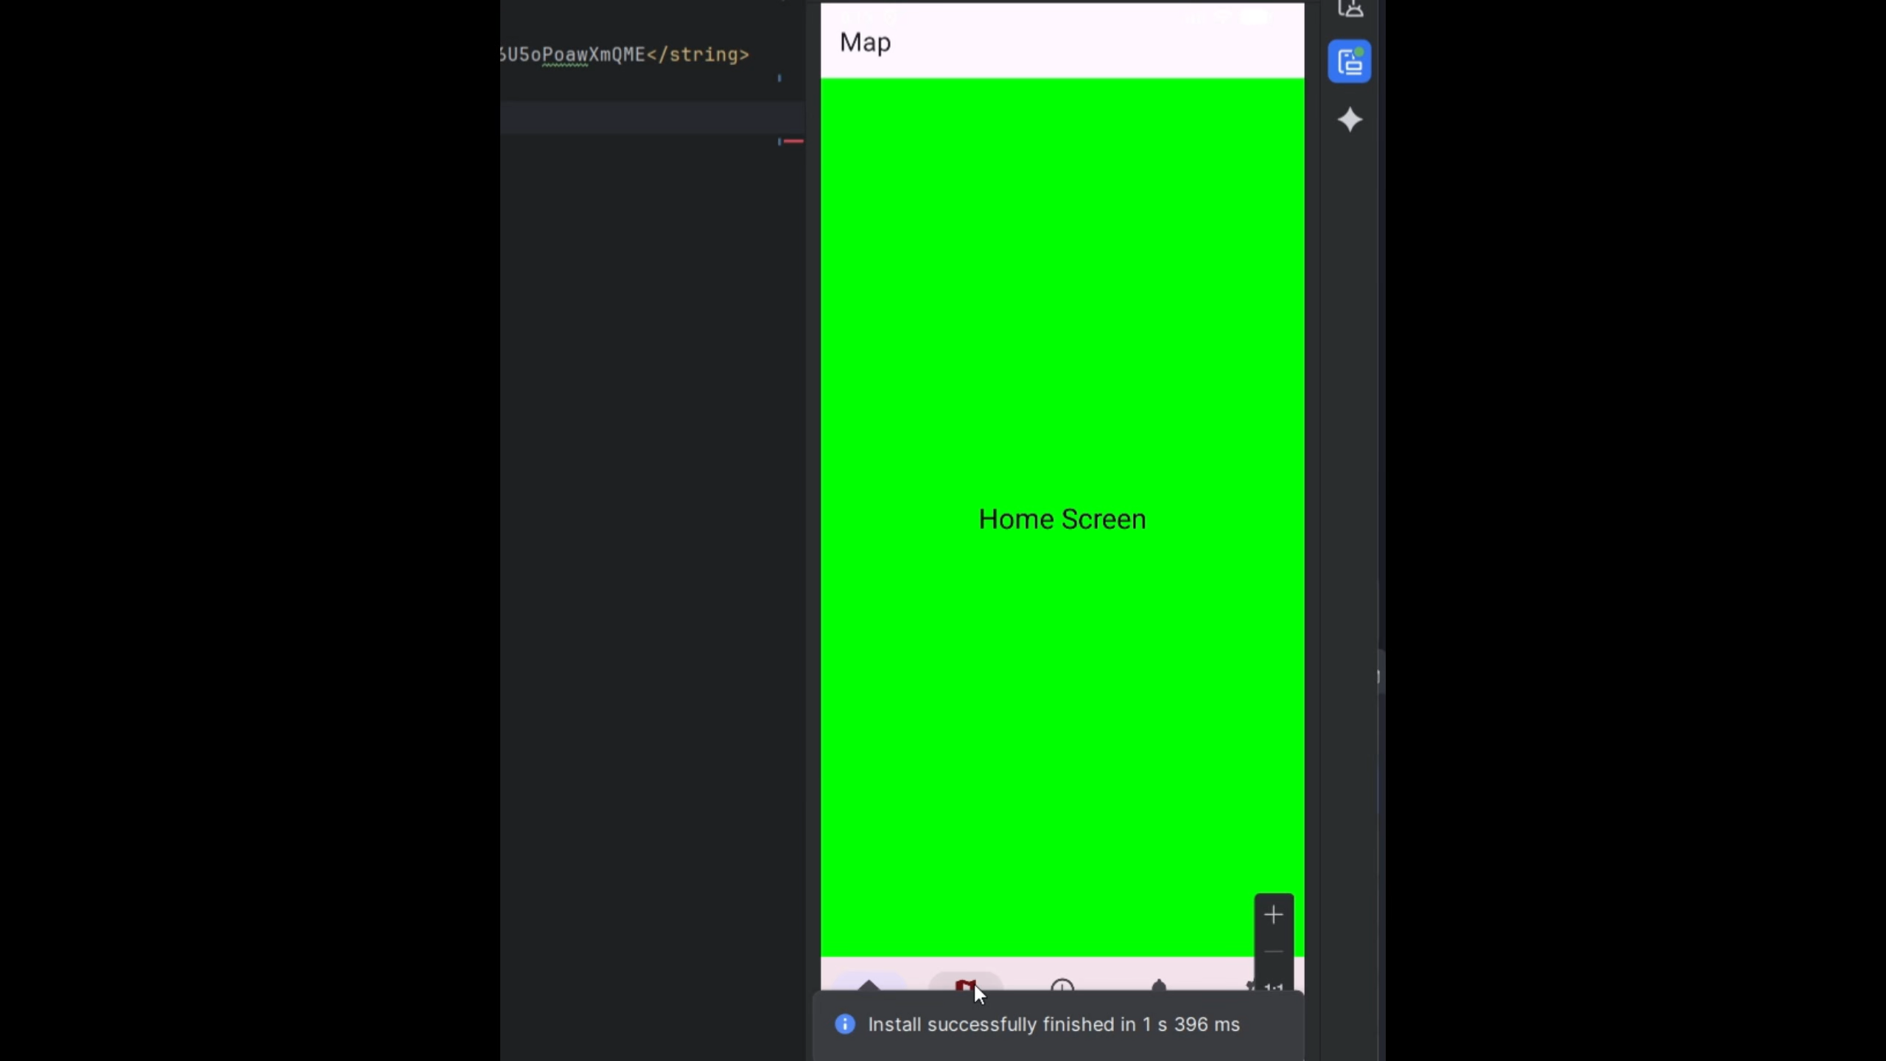



Improved Mapping

Slide 4
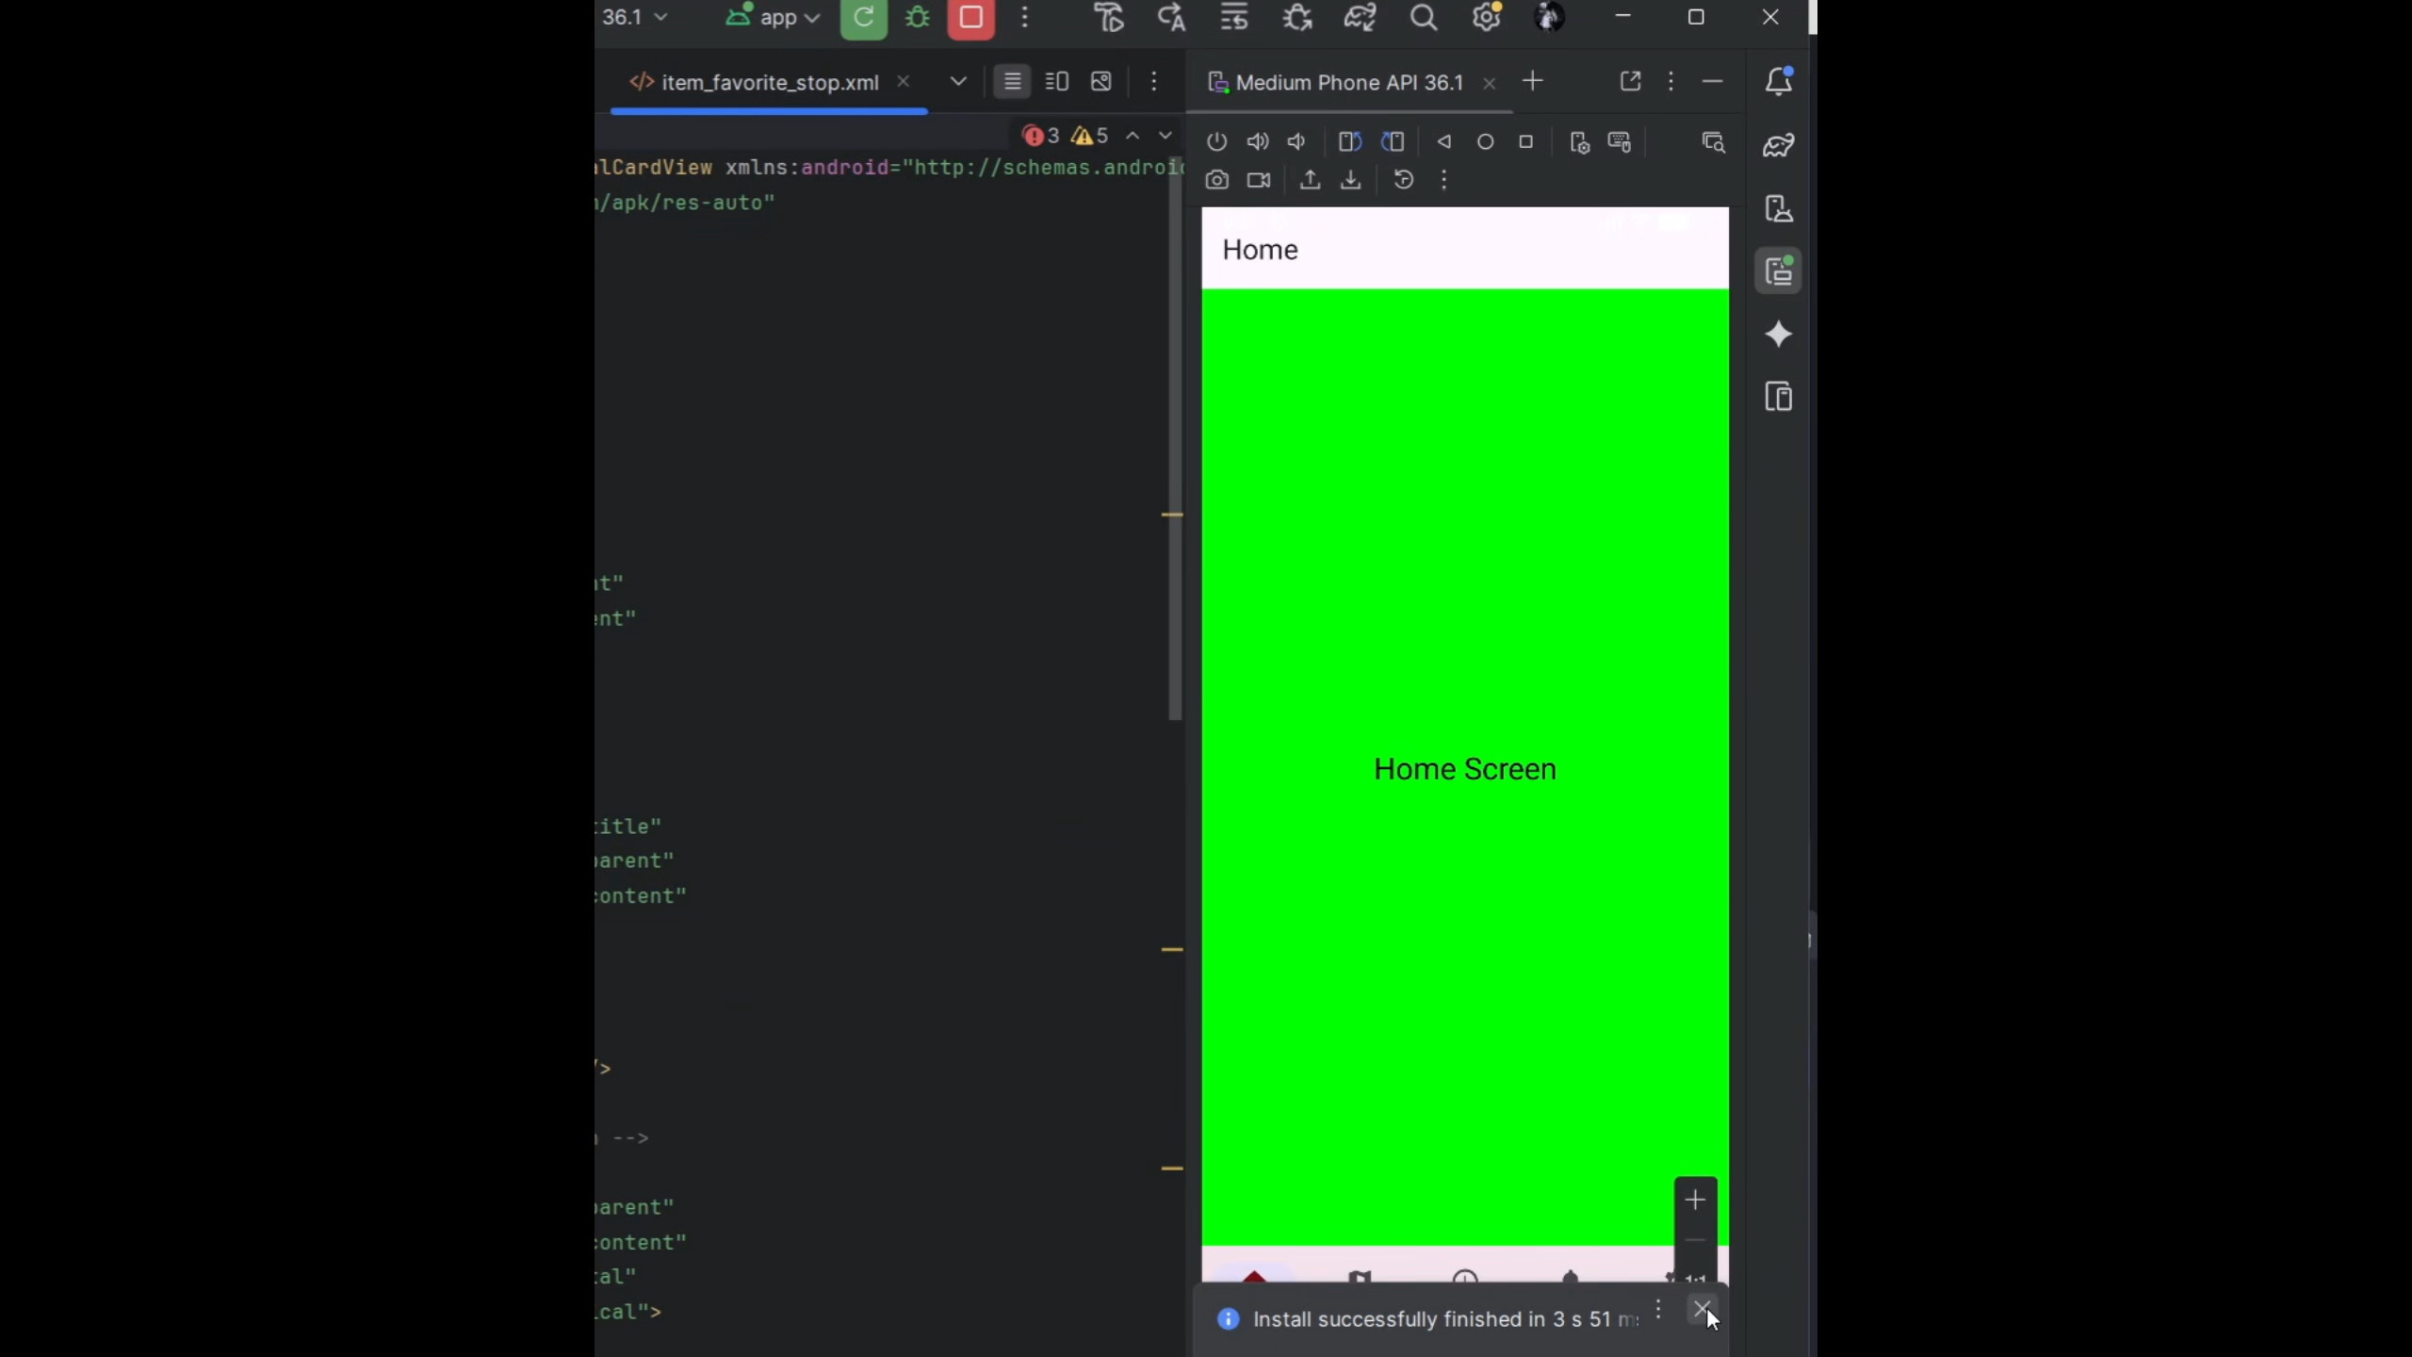

Settings Tab

Slide 5
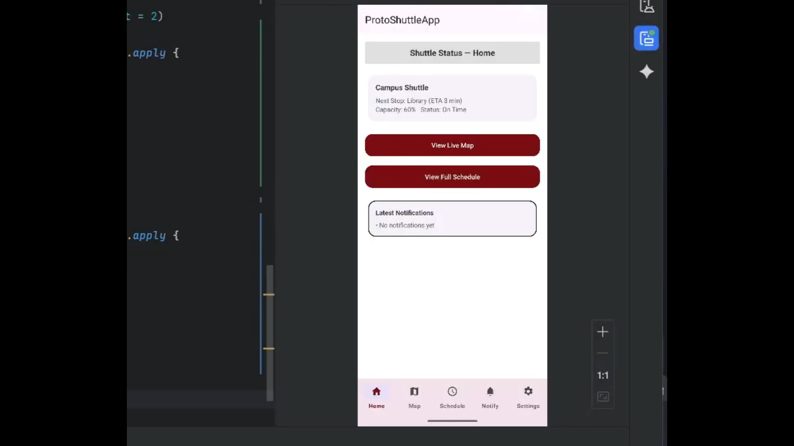

Home Tab

Slide 6
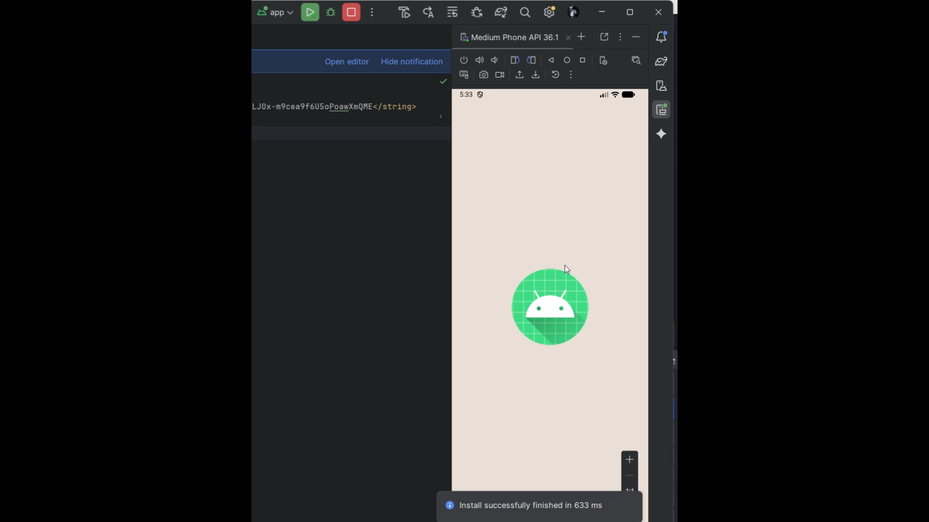

Drivers “side”

Slide 7
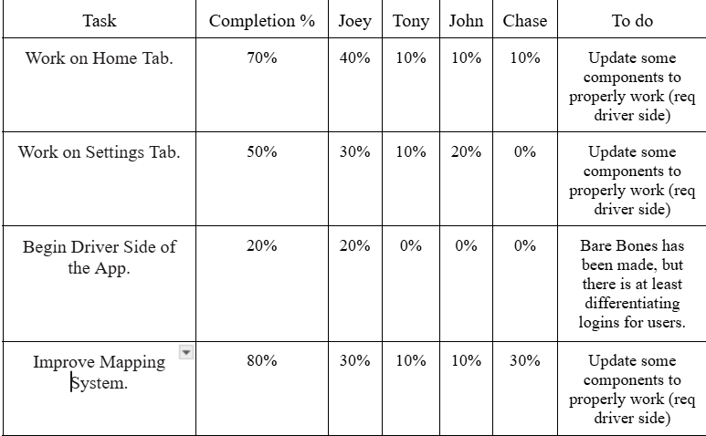


Milestone 4 Progress

Slide 8
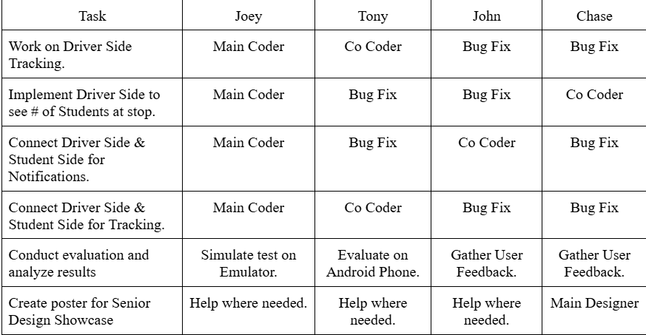
Milestone 5 Plan

Slide 9






QUESTIONS?
Visit our website
https://yanarex.github.io/shuttle-app-website/

